Slide 1



Grouping Data with GROUP BY Clause in SQL

Slide 2
This presentation provides a comprehensive overview of the GROUP BY clause in SQL,
demonstrating its basic syntax, usage with multiple columns,
integration with the HAVING clause,
and practical examples to group data based on common attributes.

Slide 3


Introduction to GROUP BY Clause
What is GROUP BY?
A clause in SQL used to arrange identical data into groups.
Why Use GROUP BY?
To aggregate data and perform operations on each group like COUNT, SUM, AVG, etc..
Importance:
Essential for data analysis and summarization.
Helps in generating reports and insights from datasets.

Slide 4
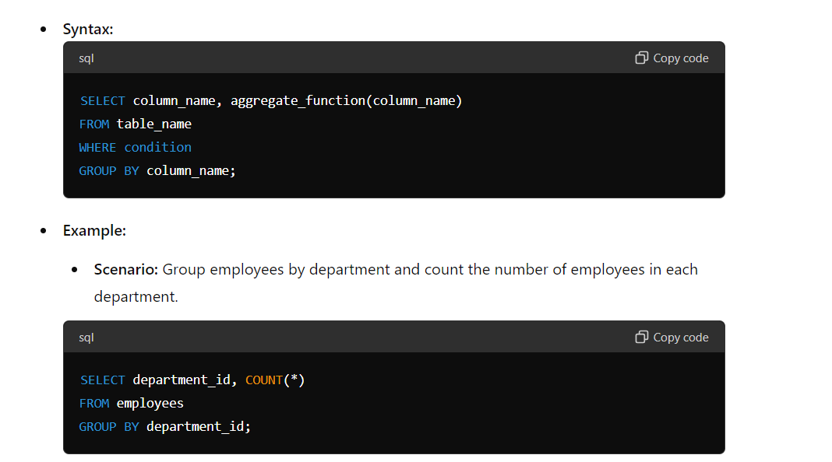
Basic Syntax and Usage

Slide 5
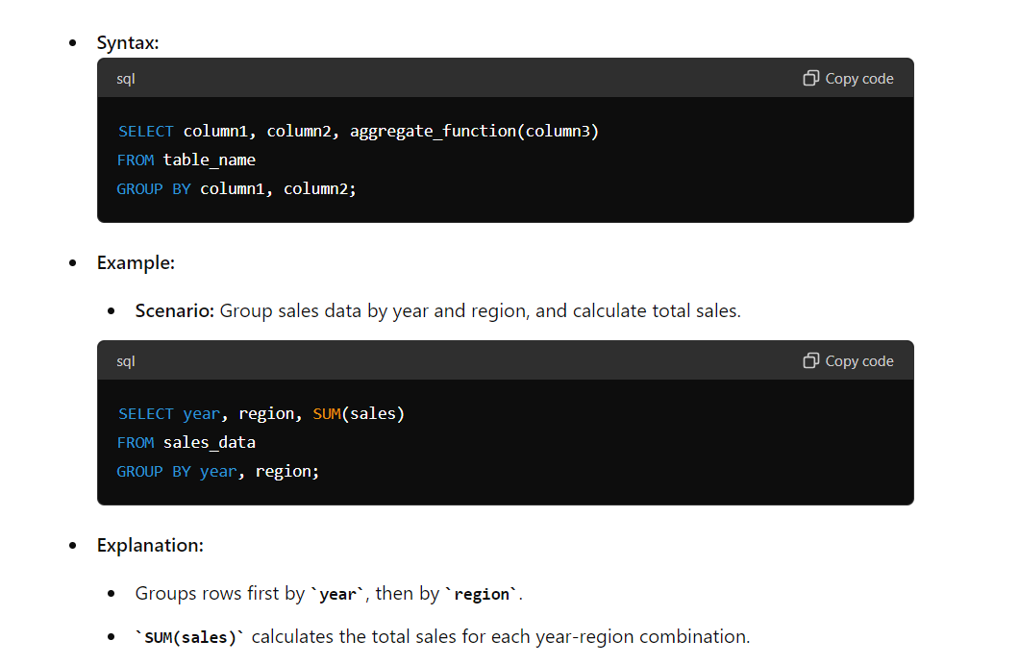
GROUP BY with Multiple Columns

Slide 6
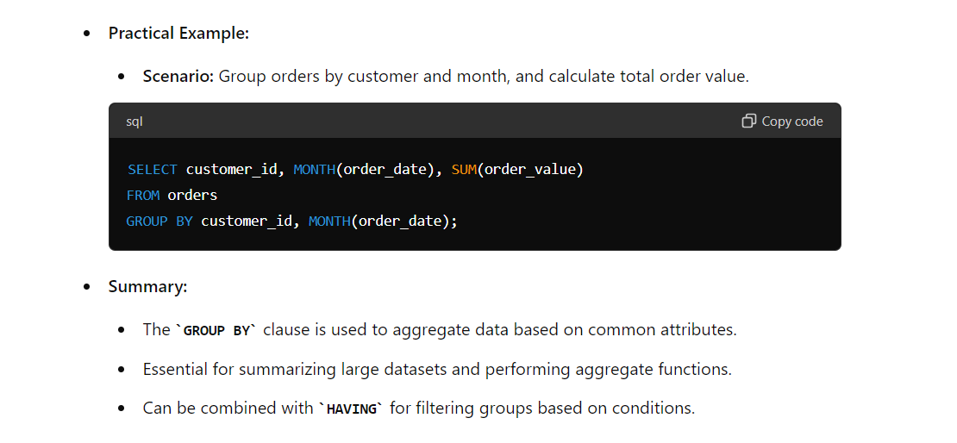
Practical Example and Summary

